Slide 1
RESEARCH METHODS IN COMPUTING & TECHNOLOGY
Subject code:CT098-3-2
Shivam Ranabhat
NPI000047
Assignment Topic: ESports Recruit System

Slide 2
Introduction
Proposed recruit system is especially for the battle royal games in Nepal
Will be assistive for eSports players of battleground games
Making them easier in their team formation
Chat with each other
Getting sponsor organization.
And help organizations to recruit better players of their choice
System will bring an adverse change in the sector of eSports so that
The competition will be high and
The desire of every player for eSports tournaments will be increased

Slide 3
Problem Statements
Most of the recruitment platforms are web-based which are hard to find and use for recruitment
Most of the players in that platform are from Europe and North America which is another problem for Nepalese players
Lack of chat server in available Recruit system to connect players and Sponsor organizations.

Slide 4
Aims & Objectives
To provide a system in Nepal that will help players to find teammates of their level, the best team manager, and the team organization to grow the eSports community
Objectives
To analyze problems faced by Nepalese ESports players
To propose a system that assists them to seek teammates of their level.
To provide a system that uses a database to store gaming CVs and profiles including their gameplay clips of players
To provide a system where team managers, casters, and organizations can also build their profiles for recruitment.
To use a chat server and a database to connect players, managers, and team organizations

Slide 5
Research Questions
Domain
What would be the effect of introducing a new system in Nepal for recruiting eSports players?
What are the drawbacks of the existing system in the eSports community?
How does an eSports player, team manager, and the organization get to benefit from such a system?
Technical
How does the CV and game clips stored in the database help the players to find teammates, team manager, and organization?
Where does the message will be stored when a user sent a message and suddenly goes offline?
How will the mechanism in the chat server work when a user sends a message and goes offline?

Slide 6
Significance Of The Work
Designing a system that helps the eSports players to find better teammates, team coaches, and organization
Assist an eSports player to make their profile and CV in that system
Provide a positive impact and help to grow the Nepalese eSports community
Chat server to connect the players to each other

Slide 7
Methodology
Chosen qualitative research in this study to gather more exact data
Qualitative research is to investigate the related people’s perspectives and thought and analyze them
Online survey preparing some questionnaires for respondents as a primary resource
Research articles, papers, and publications will be referred to as secondary resources
Qualitative online survey will be done to get the opinions and experiences of the players
To collect the data from more eSports players snowball sampling approach will be used in this study

Slide 8
Overview Of The Proposed System
Consists of a database system and chat system
Designed a system which will be a mobile application that is divided into three main features
Registration,
Recruiting process, and
Chatting
Will implement an approval process from admin to make system more secure

Slide 9
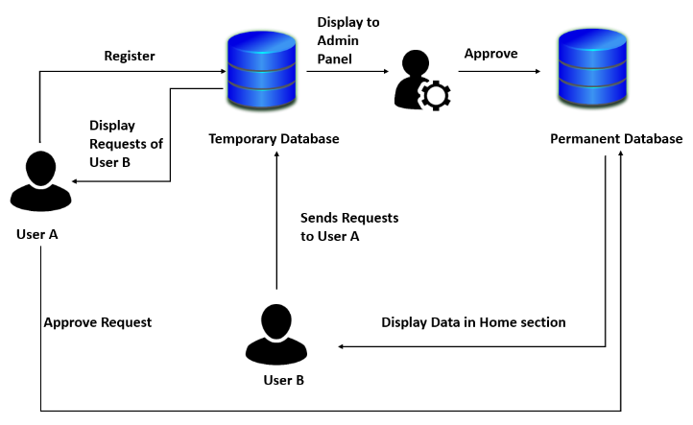
Registration & Recruit Process

Slide 10
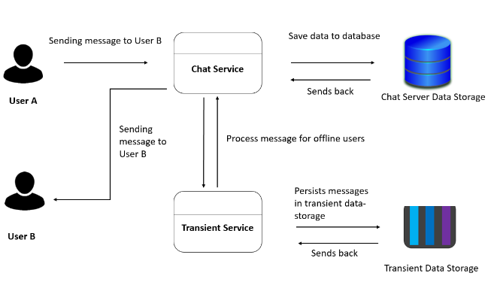
Chat Process

Slide 11
Conclusion
This project will require a significant amount of attention, work, and patience
This research helps to propose a mobile application for recruiting eSports players
Will provide a positive impact on the Nepalese eSports community solving the major problems
System will be secure preventing fraud cases and chatting feature

Slide 12
References
American Journal of Recruit-System for ESports, 1992. Chapters ESports recruit system 471 new ASHP members in the spring campaign. 49(10), pp.2374-2374.
Bassat, A. & Rockman, M. (2010). Seek-Team For ESports Players. International Research Journal of ESports Recruit System (IRJERS), 07(05).
Brickell, A., 2017. Addressing Integrity and Regularity Problems in ESports Recruit: THE RESPONSIBILITY OF THE WHOLE ESPORTS COMMUNITY. Gaming Law Review, 21(8), pp.603-609.
Cranmer, E., Han, D., van Gisbergen, M. and Jung, T., 2021. ESports Analytics Tools Matrix: Structuring the ESports research agenda. Computers in Human Behavior, 117, p.106671.
Deshdeep, N., 2018. App or Website? 10 Reasons Why Apps Are Better for ESports Players Recruit | VWO. [online] Journal. Available at: <https://vwo.com/blog/10-reasons-mobile-apps-are-better/> [Accessed 10 March 2022].
Hong, H., 2022. eSports: the need for a structured support system for players. European Sport Management Quarterly, pp.1-24.

